Slide 1

An app for freelancers and those seeking freelancers for work in Charlotte, NC.
Don’t outsource your project to a different country or state.
Hire your neighbor instead.
CREATED BY:
Cam Burrows
Lead, Back-end
Abby Olaleye
Front-end
Tim Hayes
Back-end

Slide 2
Why We Chose this Project
Given the choice and at equal cost, most people prefer to spend their money within their community.
In addition to the obvious financial benefits for the area in question (for us, Charlotte), this helps foster a sense of community.
Users can either put themselves and their skills out there for others to see and hire them, or they can post a job and let freelancers offer them their services.

Slide 3


New Technologies
An authentication middleware for Node.js
A CSS preprocessor

Slide 4
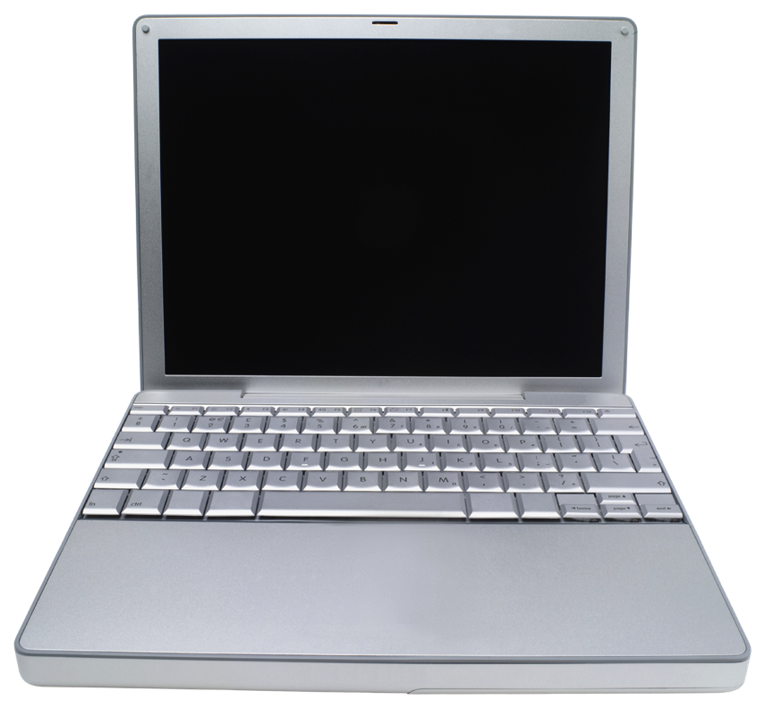
DEMO

Slide 5
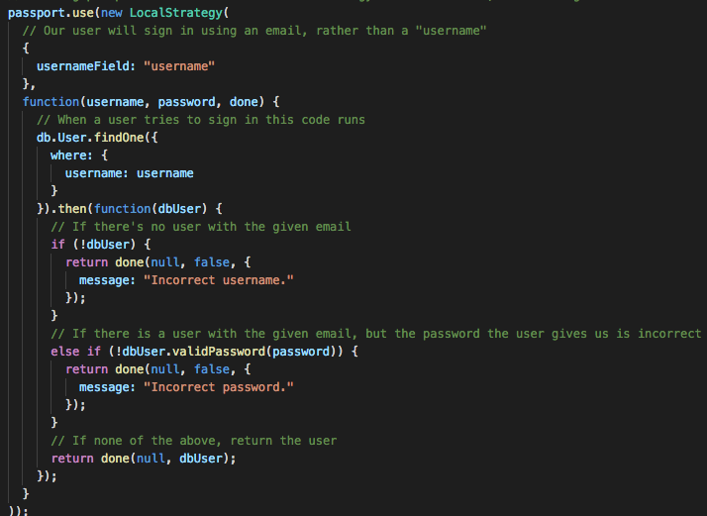
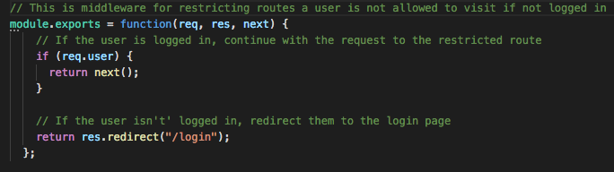
Keys to Passport Local Strategy

Slide 6
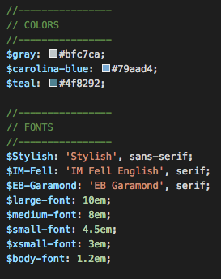
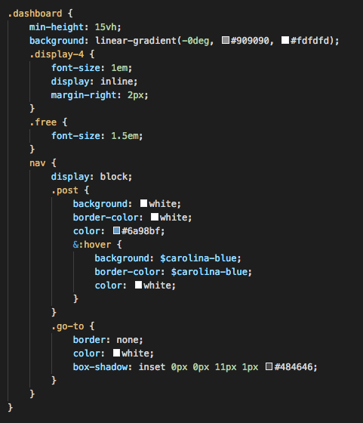
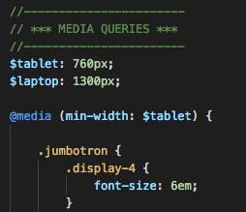
Working with Sass

Slide 7
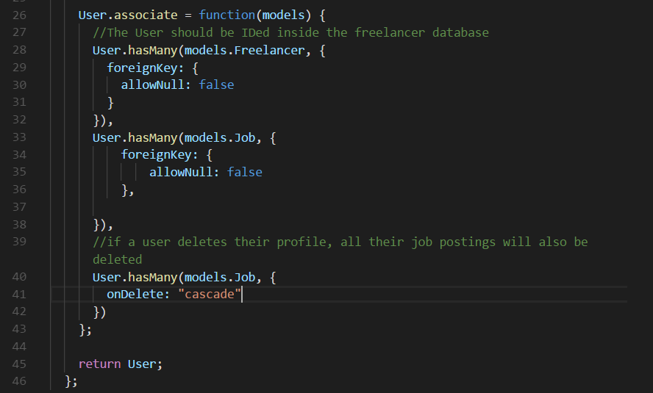
Working with the Database
and Upcoming Implementation

Slide 8
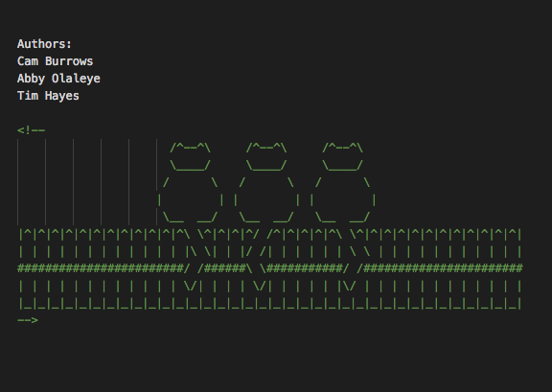
Any Questions?

